Slide 1
Meeting 24/02/2020
Naudé Conradie
19673418

Slide 2
Theoretical Work
Run simulation in Marc Mentat
Mentat python modules working

Slide 3
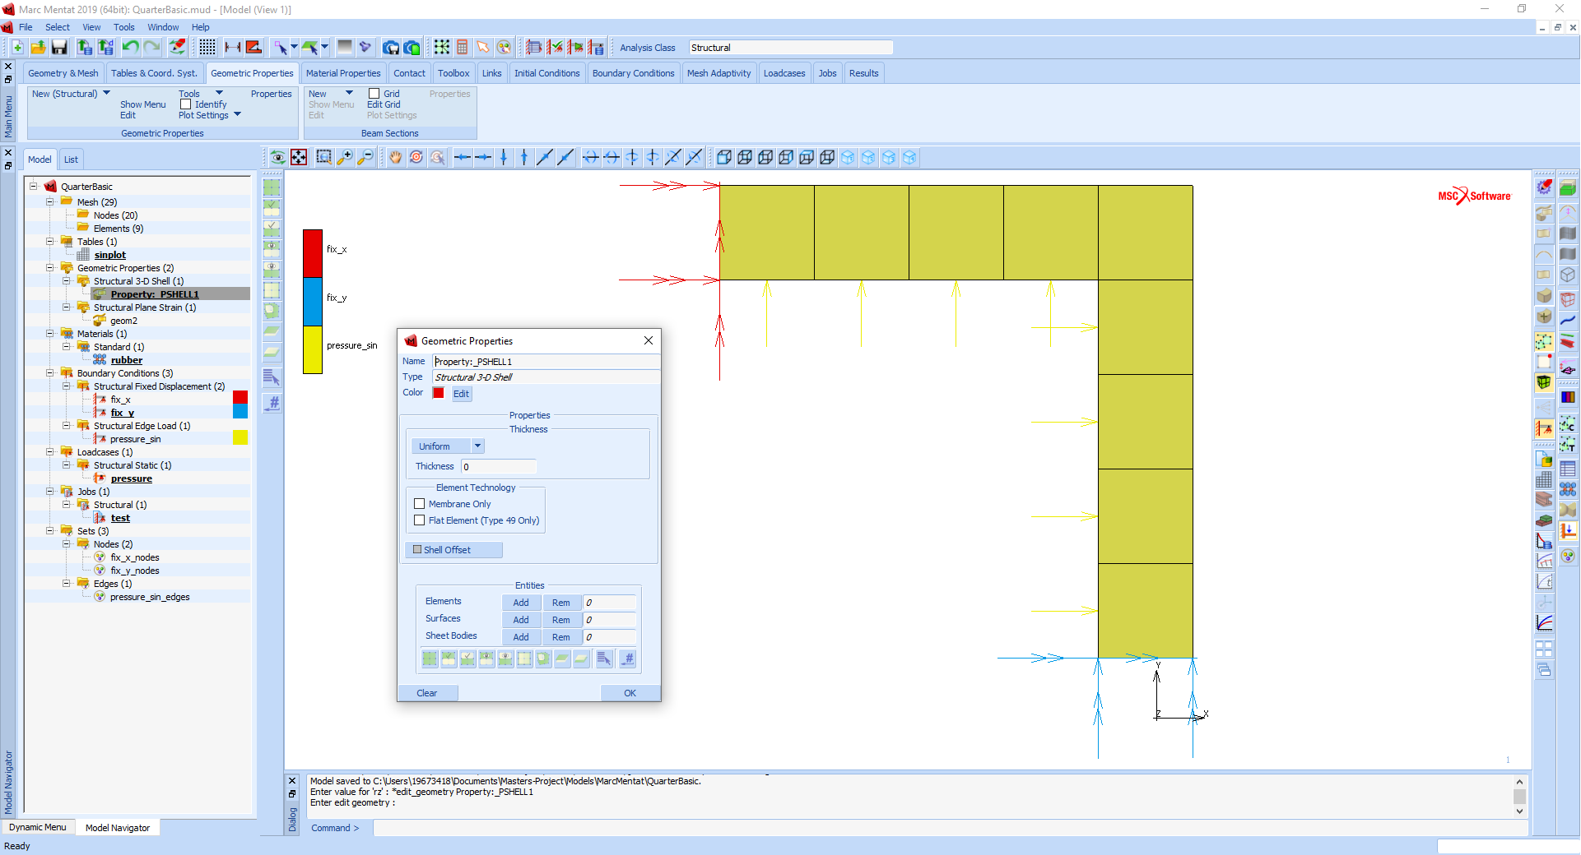

Slide 4
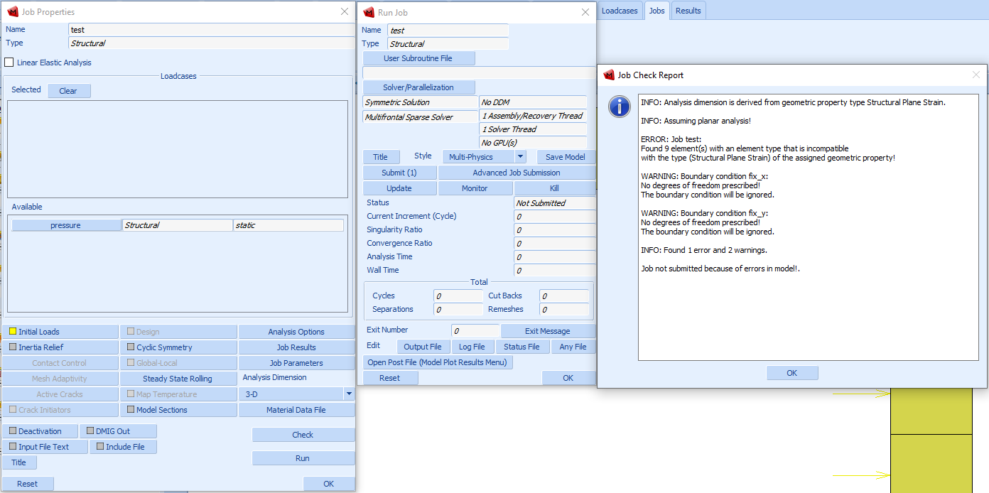

Slide 5
Lab Work
Start testing with Instron & long travel extensometer today
Out of material for Mold Star 15

Slide 6
Admin
Quarterly report
Length
SACAM Conference
Paper
Keys
R35 per key * 6 = R210
Mr. Zietsman prefers not locking the door and using student cards
New WhatsApp group

